Slide 1
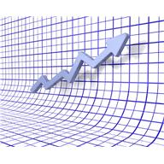
Data Team Process Review
Fulton High School
February 2016
Ginny Vandelicht
Hook Center for Educational Renewal

Slide 2
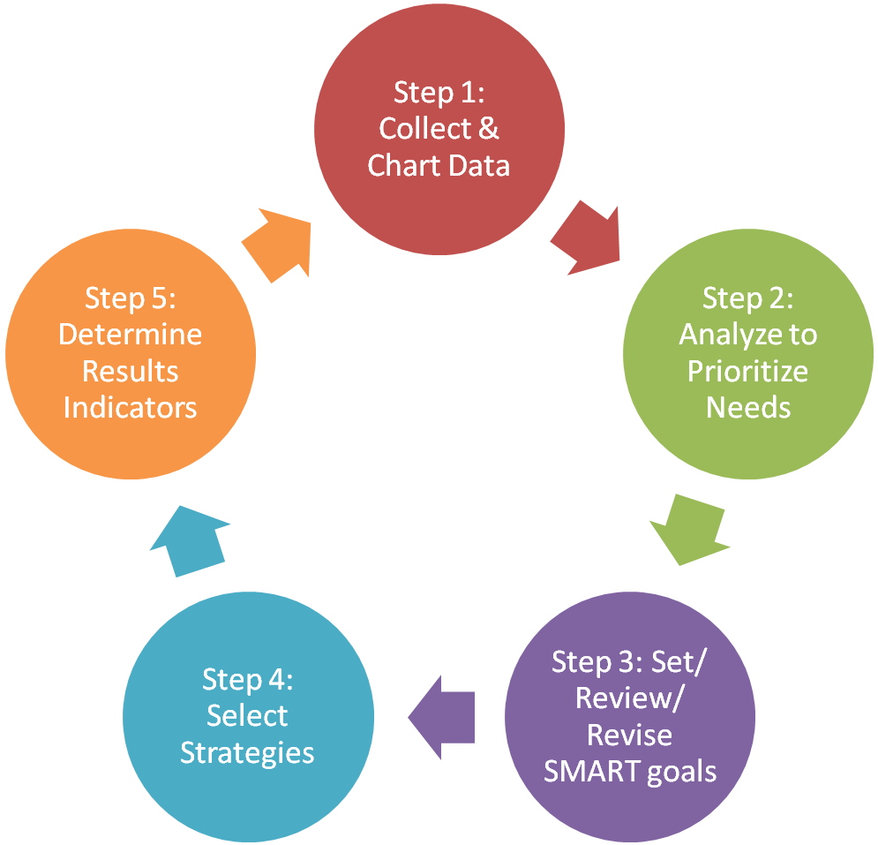
The DT Steps….One more time.
Step 6: Monitor and
Evaluate the Results

Slide 3
Before you begin…
Create a pre-assessment that gives you a quick look at your upcoming instruction…
What are the essential (priority) skills and concepts that you will be teaching?
How will students have to demonstrate that they know and can do the new learning?
How can you know what errors in thinking or misconceptions students have about the new learning?
How will you determine which students go into which of the 4 groups?
Administer and score the pre-assessment

Slide 4
Step 1 Collect and Chart the Data
 | # who took assessessment | # & names 0f Prof. | % Proficient | # and names of Close | % Close to Proficient
Teacher 1 Or Class 1
Teacher 2 Or Class 2
Teacher 3 Or Class 3

Slide 5
Step 2 Analyze to Prioritize
What are the Strengths of each group?
For Proficient…how will you stretch their learning?
For Far But Likely and Far But Not Likely..how will you use their strengths to leverage their learning?
What are the Misconceptions or Errors in Thinking for each group?
What do their errors tell you about their understanding or lack of understanding?
What are the skills/concepts each group needs to focus on to move their learning?

Slide 6
Step 3 Set a SMART Goal
The percentage of __________ (student group)
scoring Proficient or higher in ____________
(content or skill area) will increase from _____ %
to _______% (prof. + close + far but likely) by
the end of __________ (week, month, unit) as
measured by ____________ (assessment tool)
administered on __________. (date of post
assessment)

Slide 7
Step 4 Select Instructional Strategies
Select strategies for specific misconceptions or errors in thinking in Step 2.
Match the strategy tightly to the error or misconception.
Choose research-based strategies.

Slide 8
Step 5 Set Results Indicators
Answer the question: “How will we know if our strategies are working?”
Tied to the Instructional Strategies
Describe what you will see if the strategies are working to improve student learning
Adult Behavior (Cause Data)
Student Behavior (Effect Data)
Student Work
Data should be intentionally collected from the Results Indicators.

Slide 9
Monitoring the Process
Continuously throughout the cycle
Formatively assessing
Collecting both cause and effect data
Need to meet with your collaborative team at least once during the cycle to discuss what is happening and make adjustments.

Slide 10
Other things to consider…
How many units do you teach during a school year?
How many DT cycles might you be able to get in this year?
What are the essential (priority) standards that you want to collect data around?
Mini (shorter) DT cycles (for RtI) between regular DT cycles

Slide 11
Questions?
Comments?

